Slide 1


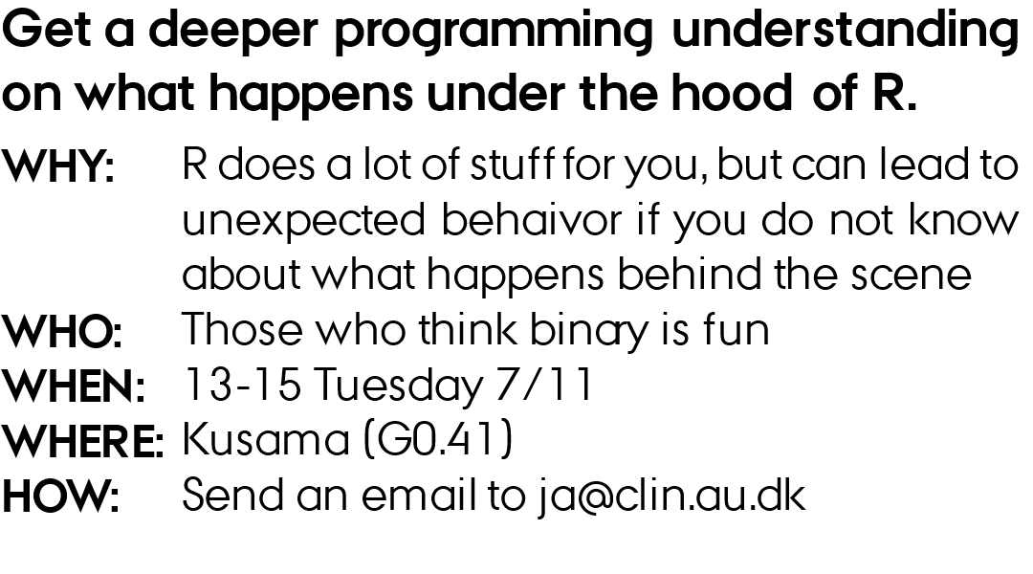
UNDERSTANDING R

Slide 2
outline
Why?
Binary
How computers store data
Data types in R
Strongly typed vs weakly typed languages
Scoping in R

Slide 3
Why?
Debugging and Troubleshooting
Efficient Code

Slide 4

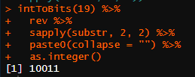
Binary
What is 10010100 in decimal?
Decimal
1337
What is 19 in binary?
1 x 1000
+
3 x 100
+
3 x 10
+
7 x 1
1 x 10³
+
3 x 10²
+
3 x 10¹
+
7 x 10⁰
Binary
1001
+
+
+
1 x 2³
0 x 2²
0 x 0¹
1 x 2⁰
+
+
+
Decimal
1 x 8
0 x 4
0 x 2
1 x 1
= 9

Slide 5
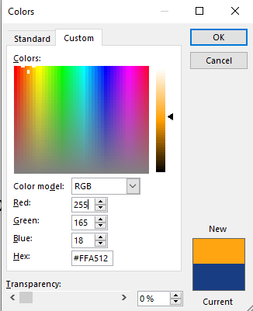
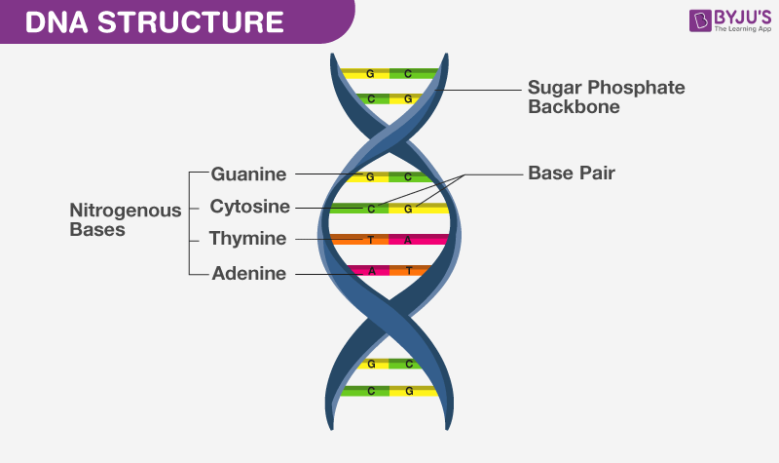
Other bases
ATCG (base 4)
Hexadecimal (base 16)
0-9 and then A-F for 10-15
YouTube ( base 64)
64^12 - 1
https://www.youtube.com/watch?v=dQw4w9WgXcQ

Slide 6
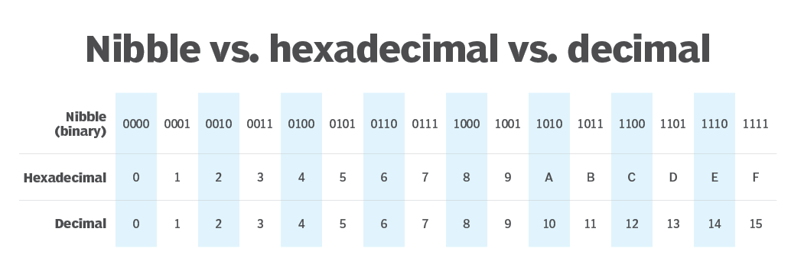
Bits and bytes
Nibble (4 bits)
Bit
1
0
1
0
0
1
1
0
Byte (8 bits)
1 kilobyte = 1024 bytes (2^10 bytes)
1 megabyte = 1024 kilobytes (2^20 bytes)

